Slide 1

1
ECTE250
ENGINEERING
DESIGN
AND
MANAGEMENT
2
Winter 2025/Spring 2025
Introduction to Project

Slide 2

Outline
◻ Project
◉ Theme
◉ Technical
◻
Budget
◉ Parts
◉ Consultation
◉ Labor
Requirements
◉ Complexity Factor
◉ Equipment and Parts
◻ Deliverables
◉ Peer Evaluation
◻
Team Roles
◉ Design
◉ Organizational
◉ Meeting and Reporting
◉ Logbooks
2

Slide 3
Project

Slide 4
Theme
◻ Structured team design activity covering the first four phases
of a product design cycle. Student teams will undertake
the
entire project using staff
◉ Detailed Design
◉ Simulation
◉ Breadboard Prototype
as
‘costed’
advisors.
◉ Perfoboard
/ PCB Prototype
4

Slide 5
Theme
◻ Theme: IoT and their applications
The major sub-theme for this year is IoT and their applications:
- In transport and traffic management
- In health (aged care – dementia etc)
- In manufacturing industry (IR 4.0)
In humanitarian engineering (low cost engineering solutions for those needed)
Parking detection and resources sharing Systems using Electrical Systems
Electrical devices that enhance student learning in years K-12.
Reduce, Reuse, Recycle: promote a ‘green’ behavior by minimize the negative impact of mankind on our planet (e.g. waste, pollution, energy, natural resources). The theme aims at minimum electrical power usage and maximum functionality.
- Similar IOT applications as above
As an aside IEEE has standardized some of these systems with conferences such as the world forum on the Internet of things: http://sites.ieee.org/wf-iot/
5

Slide 6
Theme
◻ Internet of Things based User-interactive
System
featuring:
◉ State Machine (core
◉ Sensors/Input
◉ Actuators/Outputs
of
the
system)
5

Slide 7
Requirement 1
◻ The design MUST incorporate a Mealy or Moore Synchronous State
Machine with at least 4 and no more than 8 different states
◉ this will require a maximum of three flip flops to store the state and design
of combinational logic for the state machine changes and for any state
machine outputs.
◻ The State Machine is the CORE of the system.
◻ Each state should be indicated by connection to a Light Emitting
Diode of different color (unless states can be clearly identified using other actuators).
7

Slide 8
Requirement 2
◻ The design must include
at least
one
motor
◉ DC Permanent Magnet
OR
◉ DC Servo motor
motor
◻ Both motors must be driven by
PWM
◉ The DC Permanent Magnet motor should be driven through an H-Bridge
(bi-directional)
◉ The DC Servo motor should be driven by an optoisolator
9

Slide 9
Requirement 3
◻ The design must include at least one and not more than eight
switches or push-buttons.
◻ All
digital
input
switches
must
be
de-bounced
in hardware.
10

Slide 10
Requirement 4
◻ The system is required to send and/or receive data to/from other
devices connected through the Internet.
◉ E.g. send some sort of measured data to the network-connected devices,
and/or driving actuators from data received from other network-connected devices.
◉ This must be
(expansion).
Internet
interface
is
provided
by
Arduino
and
its
Ethernet
Shield
11

Slide 11
Requirement 5
◻ The design must include a two line LCD display used to display
data.
◉ The LCD display is interfaced (control and power) by the Arduino
Subsystem.
◉ Displayed
Arduino.
data
should
be
toggled
using
a
switch
(de-bounced)
connected
to
12

Slide 12
Requirement 6
◻ The system must include one 555 Timer
◻ Option 1: the 555 generates a triangular waveform derived from a square
waveform with a duty cycle of 60%.
◉ The frequency is the average of the last 4 digits of your teams student id’s divided by 10
and rounded to the nearest integer.
◉ This represents the ‘heart beat’ for your system and must be reset by Arduino
every 100 milliseconds (this shows that the system is still ‘alive’).
◉ This circuit is not to be included in the power calculations.
◻ Option 2: the 555 Timer used for a specific functionality of your design (except for
clocking the State Machine).
◉ This circuit is be included in the power calculations.
13

Slide 13
Requirement 7
◻ Power is supplied via a dual channel supply power supply which
can deliver at most 150mA on +15/-15Volt rails.
◉ This has to power minimum two and maximum eight operational amplifiers.
◻ The Arduino Subsystem (Arduino Board, Ethernet Shield, LCD
display) are powered
via
USB
cable
connected
to
a
Computer
(or
to
a
USB
charger).
14

Slide 14
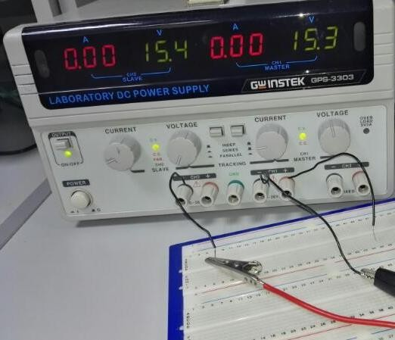








Details
on
Project
Power
Supply
button off /
released
(i.e. series configuration)
button on /
(i.e. series configuration)
pushed
Set the Voltage
and Max current
using these only
-15 V
+15 V
Any one of this can be used as Ground (Use only one)
15

Slide 15
Requirement 8
◻ The design must include minimum one and maximum three
Voltage Regulators, used to power
5V or 3.3V.
circuits that require a supply
of
◉ E.g.
generate
5V from
15V
supply,
or
generate
3.3V
from
5V
supply.
16

Slide 16
Requirement 9
◻ The total power consumption over a representative operational cycle
had to be measured and analyzed (for each state of the State
Machine).
◉ Team projects will be subject to a maximum power constraint but a main
judging criteria will be on the minimum power consumption of the system
over a representative operational cycle.
◉ To save power you can use multiplexers and small low voltage relays to
make the circuits ‘time division multiplexed’ if you wish.
◉ The Arduino sub-system (including Ethernet shield and LCD display) are not
to be included in the power analysis.
17

Slide 17
Warning
◻ ECTE250 project is not an Arduino Project!
◉ you will learn to use Arduino platform, but this is not a learning outcome of
an Engineer – designing an Arduino platform is the task of an Engineer.
◉ The Arduino sub-system (including Ethernet shield and LCD display)
represents only an interface between the State Machine and the LCD and
the State machine and the Internet (with likely a laptop on the other side).
Arduino is also used to reset the 555 Timer (if Option 1 is selected).
◉ When interfacing external circuits or the State Machine to the Arduino
Board you are requested to use opto-isolators, BJT/FET transistors, or other
signal conditioning circuits (later in the course).
18

Slide 18
Warning (cont’d)
◻ Other allowed uses of the Arduino sub-system include:
◉ Add sub-states to the state of your state machine.
◉ Generate PWM signals to drive motors.
◉ Generate time delays or timed events/signals.
◻ You can source suitable Arduino code elsewhere
(books, Internet),
but you are requested to give full referencing and credit.
19

Slide 19
Constraint 1
◻ The prototype should not be larger than the provided breadboard
(first) and perfoboard (later).
◻ Use the
display
small breadboard in the Arduino starter kit for the
LCD
circuit
only
(also
for
the
Perfoboard / PCB
prototype).
20

Slide 20
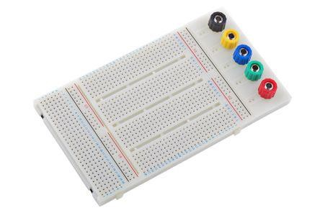
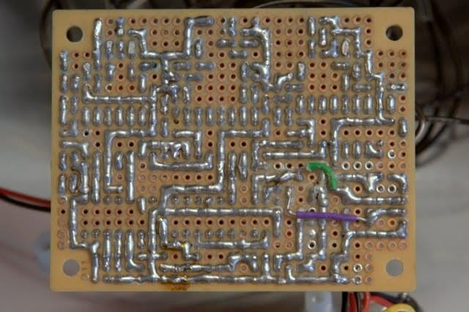
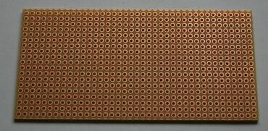
Constraint 2
◻ All accepted and fully documented designs will be prototyped
initially on a breadboard and then soldered using a perfoboard / PCB
◉ This will be done in the laboratory during formal lab sessions
own time.
and
in
your
◉ Use
IC
sockets
for
all
components
except
passive
R
and
C
21

Slide 21
Complexity
Factor
◻
Melay SM
SM with more than 4 states
SM with more than 6 states
System with 2 sensors
System with 3 sensors
System with 2 Motors
System with 1 Special Actuator
Bidirectional DC Perm. Mag with H-Bridge
DC Servo driven via optoisolator
More than 5 buttons or switches
Data sent and received from/to Internet
Switch to toggle LCD displayed data
555 Timer used as Option 2
More than 5 op amps
Smart approach to reduce power
System generating sound
+1
+1
+2
+1
+2
+1
+1
+1
+1
+1
+1
+1
+1
+1
+2
+1
design complexity
must be aligned with
functional
requirements
◻
◻
◻
◻
◻
design complexity is
used in marking
criteria of
Deliverables 2 to 6
◻
◻
◻
◻
◻
◻
Projects are expected
to have a complexity
factor within 2 to 6
◻
◻
◻
◻
22

Slide 22
Prototyping Equipment
◻ Available in Circuit Lab (no
budget for).
◉ Dual Channel Power supply (to be used
150 mA max source)
need to
as +/-
15
V,
◉ Soldering equipment (iron,
◉ Wire cutter/stripper
◉ Two Channels Oscilloscope
◉ Signal Generator
◉ Multimeter
glasses,
third
hand)
◉ Dedicated ECTE250 Network
23

Slide 23
Prototyping Consumables
◻ Available in Circuit Lab (no need
budget for).
◉ Passive components (resistors, capacitors)
◉ Wires
◉ Integrated circuits sockets
◉ Screw Terminal
to
◉ Soldering
Paste
and Soldering
Wire
24

Slide 24
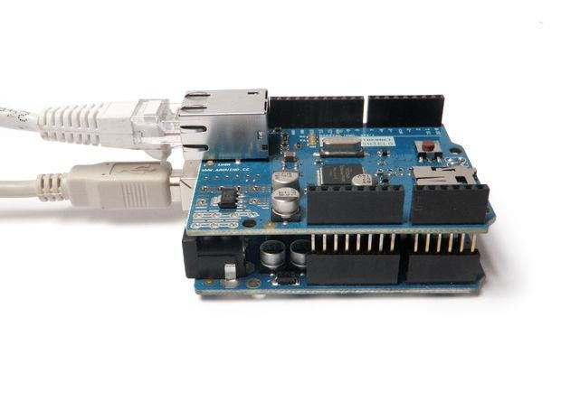
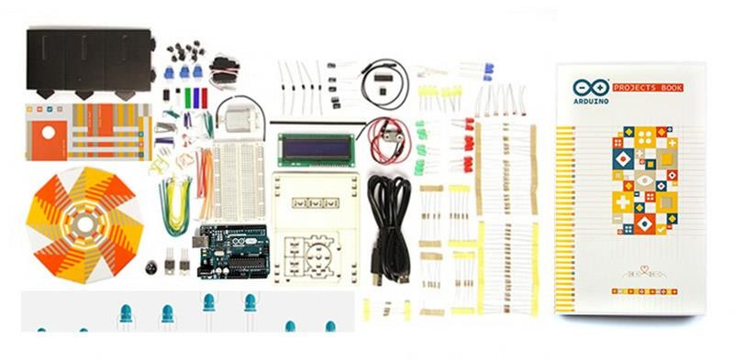
Prototyping Kit
◻ Provided to all teams, budget for 600 AED
◉ Arduino Starter Kit (includes Arduino Uno with 8-bit AVR OnBoard)
◉ Arduino Ethernet Shield (expansion Board)
◉ Large breadboard
◉ Perfoboard
◉ Ethernet cable
25

Slide 25
Prototyping
Standard
Parts
Standard Parts Max Quantity per Price
Project (AED)
NE555 timers
TL074/LF347 opamps
TL071/LF351 opamps
74LS00 (Quad 2-input NAND gate)
74HC02 (Quad 2-input NOR gate)
74LS04 (HEX inverter gate)
74LS08 (Quad 2-input AND gate)
74HC74 (Dual D type flip flops)
74HC86 (Quad 2-input XOR)
74LS90 (Decade Counter)
74LS73 (Dual JK type flip flops)
74HC151 (8 input multiplexer)
74HC138 (3-to-8 demultiplexer)
74HC161 (4 bit binary counter)
74HC164 (8 bit serial in parallel out shift register)
74HC132 (Quad 2 input NAND gate Schmitt Trigger)
BC557 (PNP transistors, complement BC547 NPN in Arduino Kits)
IRF9532 (P-Channel MOSFET, to complement IRF520 N-Channel MOSFET in Arduino Kits)
5 Volt SPST DIL Reed Relay
BD139 (NPN transistor for push pull circuit)
BD140 (PNP transistor for push pull circuit)
7805 (+5 VDC Voltage regulator, 1 amp)
LM2936 (+3.3V Voltage regulator 50mA, input 4-26Volts DC)
ULN2003 (Darlington pairs array IC)
BD649 (NPN Darlington pair)
BD650 (PNP Darlington Pair)
1N4728 (3.3V Zener diode)
1N4732 (4.7V Zener diode)
1N4743 (13V Zener diode)
8 position DIP Switch
2 5
4 6
4 5
4 4
4 4
4 4
4 4
4 4
4 4
2 5
4 8
2 5
2 5
2 6
2 5
4 8
5 2
2 5
4 8
2 4
2 4
4 4
2 8
1 9
2 8
2 8
4 2
4 2
4 2
1 4
26

Slide 26
Prototyping
Special
Parts
Special Parts: Analog Sensors and Actuators info Price
(AED)
Linear rotary potentiometer 10k ohm
Electret microphone with MAX9814 amplifier
Moisture sensor
Light variable resistor Infrared
Proximity Sensor Pressure
sensor (round 25 lbs) Thin
Film Piezo Electric Sensor
Two axis thumb joystick
Round force sensitive resistor
Flex Sensor
Ceramic Piezo Sensor/Actuator
3 Axis Accelerometer
Solenoid
Vibration motor
https://www.sparkfun.com/products/9288 ₅
https://www.adafruit.com/products/1713 ₃₀
https://www.sparkfun.com/products/13322 25
https://www.sparkfun.com/products/9088 10
https://www.sparkfun.com/products/8958 45
https://www.sparkfun.com/products/8712 80
http://www.thanksbuyer.com/meas-meas- ₂₅
high-sensitivity-ac-coupling-37169
spec-com-piezo-vibration-sensor-thin-film-
https://www.adafruit.com/product/512 30
https://www.adafruit.com/product/166 25
https://www.sparkfun.com/products/12859 ₃₀
https://www.sparkfun.com/products/10293 10
https://www.sparkfun.com/products/9267 60
http://www.robotshop.com/en/5v- ₂₅
solenoid.html
https://www.sparkfun.com/products/8449 40
27

Slide 27
Part Requisition and Rules
◻ Total budget for parts is 300 AED
◉ Extra funds can be provided if a suitable justification is provided
◻ It is strictly forbidden to
◉ use any other part/equipment sourced elsewhere
◉ store equipment or consumables in the lockers
◻ Each team can purchase at most 1 Special Part
◻ Alternatively, teams can request for 1 Part that is not
■ The part must be an analog sensor.
in that
list.
■ Teams must submit a request to the mentor by S1-W13, including motivation and
technical details on how the part will be used and integrated.
28

Slide 28
Part Requisition and Rules
◻ Parts must be requested to the Lab Engineers via
part requisition form
email
filling
a
◻ Expect up to 5 working
collection
days for parts to be ready
for
◻ Test the functionality of
your parts after collection
◻ Damaged parts will be replaced for free only once
◉ Thereafter you have buy the part again (and allocate budget
for it).
29

Slide 29
Deliverables

Slide 30
Peer Evaluation (PE)
◻ All deliverables require all team members to complete a Fair Contribution Sheet.
◻ You will receive an email when the session opens, and a reminder 24h
before it closes (if you haven’t submitted it yet).
◻ Submission opens 5 days before the deliverable due date.
◻ Submission closes time/date is identical to the deliverable due date/time.
◻ Individual penalty for late submission of the PE is 50% of the mark for each
working day after the due date.
32

Slide 31
Group Projects- How to assess individual contribution
Fair Contribution Sheet
Used to assess the contribution of team members to the team
Individual contributions are recognised through awarding of bonus marks
But remember there’s no ‘i’ in ‘team’
Individual non-contributions are penalised with a negative bonus
Poor contributors don’t deserve to get the same marks as the contributing team members
35

Slide 32
How does the FCS work?
Each team member is assigned a value of 20 marks
SCHOOL OF ELECTRICAL, COMPUTER AND TELECOMMUNICATIONS ENGINEERING
ECTE250 Fair Contribution Sheet
Team No:....?......Year: Winter ????..
Team Name ………………………… Number of students in Team:…5. …….
Mark Pool (multiply no. in team by 20):…?? …… FCS Number or Seminar Activity
or Team rules:………………...………………….. ALL STUDENTS MUST SIGN AGREEEMENT
Date:…………………………………
Student Name and Signature:
Student Name and Signature:
– Total mark pool = number of students×20
Assessment Task | Mark
Attendance; Discussion / Team Participation; Participation as Role; Contribution to Deliverable
Assessment Task | Mark
Attendance; Discussion / Team Participation; Participation as Role; Contribution to Deliverable
Teams agree on mark allocation for each student
All scores must be integers
Student Name and Signature:
Student Name and Signature:
Assessment Task | Mark
Attendance; Discussion / Team Participation; Participation as Role; Contribution to Deliverable
Assessment Task | Mark
Attendance; Discussion / Team Participation; Participation as Role; Contribution to Deliverable
Student Name and Signature:
Student Name and Signature:
Assessment Task | Mark
Attendance; Discussion / Team Participation; Participation as Role; Contribution to Deliverable

Slide 33
Example FCS
FCS for Six students
Team Mark- 21/25
Student 1- 24
Student 2- 21
Student 3-20
Student 4-20
Student 5-19
Student 6-16
Individual mark Student 1- 25
Student 2- 22
Student 3-21
Student 4-21
Student 5-17
Student 6-14
Total-120
37

Slide 34
How do you judge the Fair Contribution?
Its’ up to the teams to decide
Everyone should agree on their own criteria at the start of the project
A contributing team member will:
meet deadlines
attend team meetings
respect team decisions
work consistently
regularly communicate with the rest of the team
work co-operatively rather than competitively
seek help and advice from the team
Every team must develop a measurable metric to award FCS marks to their team members
Time spend on the project task
Measurable metrics could involve
Completion on the project task
Overall management of the project etc

Slide 35
Team issues, what to do?
Teams are strongly discouraged from using Facebook or similar software as we have had issues with some Teams in the past that have used this medium.
If your team uses Facebook or similar external software to communicate activities and events between team members and an individual in the team experience issues that may need to be investigated, then logs on Facebook will not be acceptable as evidence of these issues.
Instead all teams have access to a Team discussion forum – use this, you have to any way as..

Slide 36
Team issues, what to do?
All Teams should meet and discuss the project at least once in two weeks
All Teams should have a Team Leader and roles of Team Members clearly defined and agreed by all members
ALL TEAM MEMBERS MUST ONCE IN 2 WEEKS DURING WINTER AND SPRING SESSIONS POST A BULLETIN IN THE TEAM DISCUSSION FORUM which outlines:
Your current role in the team
Your agreed activities/duties
Progress in the last week (even if no progress) ie what has been done by you with respect to the teams agreed project.
40

Slide 37
Team issues, what to do?
ALL TEAM MEMBERS MUST AT LEAST ONCE IN 2 WEEKS DURING WINTER AND SPRING SESSIONS POST IN THE GROUP DISCUSSION FORUM which outlines(cont..):
Any issues that concern you (so other team members, mentors and coordinator can read this, if you think something is unfair, you must log it in this area including disputes about FCS).
you must log the issue(s) which need resolution. It might be that you don’t know what to do.
State that here and early so others can either re-assign your duties or see the coordinator. Failure to do this and then to see coordinator later in the year will result in your complaint being referred to higher authorities at best, and dismissed at worst.

Slide 38
Non contributing team members?
The following procedure is available to teams who believe that a team member is not contributing meaningfully to the team activities. The stages should be followed in order, assuming the problem is not resolved:
talk as a team with the team member;
minute the meeting and;
ask the tutor and then the Subject Co-ordinator to speak with the team member.
If the team member is invited to the meeting for this purpose [and has been informed by the corresponding team members (probably the team leader) that this was the purpose] and does not turn up, follow the procedure and see the co-ordinator any way.
It is important to realise that a student may fail the subject individually without significant impact on the overall team. However, carrying a team member who is making no effort is not encouraged. This does the team member and the team overall no favours.
42

Slide 39
Consequences of non-contribution
The Co- ordinator, upon identifying a non- contributing student, may
attempt to contact the student via SOLS email to request a meeting to discuss the students lack of contribution to the project and performance in the subject.
If the student does not respond and continue not contributing will ultimately lead to failing this subject.
43

Slide 40
Some important points to note
All teams should select a Team Leader by Week 1. Team leader roles includes- team meeting coordination, submission of FCS, team point of contact etc.
Teams should have a name
All team members must post their progress (at least once in two weeks) in the group discussion forum- This is compulsory and is monitored by the tutor and coordinator
All team members should be involved in the technical aspects of the project
Have at least one meeting in every two weeks.

Slide 41
Budget

Slide 42
Budget for Parts
◻ 900 AED
◉ 600 for prototyping kit
◉ up to 300 for parts and 1
special part
◻ Saving money for parts is not a marking criteria
◉ Is better to have a more functionalities and using more
budget than few functionalities and saving budget
◻ However, justification of why a part is needed
marking criteria
is a
34

Slide 43
Budget for Consultation
◻ Consultation: asking for advices (i.e. we wont do your work)
◻ Free 15 min. weekly with Mentor (not technical consultation, not
cumulative)
◻ Consulting time with Academic Staff: AED 500/hour
◉ Limit to AED 1000, requires Mentor’s approval, min 30 min.
◻ Consulting time with Tutor/Lab Engineer: AED 400/hour
◉ Limit to AED 800, requires Mentor’s approval, min 30 min.
◻ You have this budget, you are supposed to spend it!
◻ In the reports, combine this expenditure with Labor Budget
35

Slide 44
Budget
for Labor
◻ No limit
◻ Labor cost for team members
is AED 300/hour
◻ Track the hours that each member spend on the project
◻ Compare the initial forecast with the final actual
on labor, and justify any significant deviation
expenditure
36

Slide 45
Team Roles

Slide 46
Choice of teams
Everyone has been put into teams of 4 to 5 students
You have been formed into Teams based on your selected laboratory time slots
Changing the time of your Laboratory means probably moving to a different team.
ALL activities in ECTE250 are based on campus, no exceptions.
34

Slide 47
Team Design Roles
◻ Teams are composed by 4 or 5 members.
◻ Each team member has a fixed design role and a fixed design logbook
◉ State Machine Subsystem Designer (including clocking circuit)
◉ State Machine Integration Designer
◉ Arduino Subsystem Designer (including Network a nd LCD)
◉ Sensing Subsystem Designer (including sensor circuit and ADC)
◉ Auxiliary Subsystem Designer (including power supply, motor, timer,
debouncing)
38

Slide 48
Team Organizational
Roles
◻ Rotating Roles (at least every 4 weeks)
◉ Managing Director (Chair or Team Leader)
◉ Secretary
◉ Finance
◉ Project Planning and Control including managing of WH&S requirements
◉ Quality Assurance and Sustainability
◉ Sales/Marketing
◻ Please refer to the Project Booklet for details on the duties of each role.
◻ There must be a logbook for each role. These logbooks must be handed over as the roles rotates.
39

Slide 49
Meeting and Reporting
◻ At least 1 face-to-face meeting every 2 weeks
◻ At least brief individual report every 2 weeks (submit online in Fortnightly report)
◻ The secretary must attach to
the fortnightly meeting
his/her report
the minute
of
◻ Use the template and submission guidelines
Moodle
available on
40

Slide 50
Log Books
◻ Every time you work on the project as a designer or
as your organizational role, create an entry in the
respective logbook including DATE and hours you
worked (easier to measure labor hours).
◻ Detail the activity you are working on, develop
ideas, draft your outcomes, etc…
your
◻ In your weekly report you will include a summary of
what’s is in your logbook (evidence of your work).
41

Slide 51
Your tutor/lab demonstrator
Meant to provide support and guidance to the team
They are NOT there to do your project!
The tutor is the first point of contact for any issues
Will be running the lab sessions

Slide 52
Coordinator as Multiplexer!
If your team seeks academic advice you must first see the tutor (during lab sessions), explain the problem that you wish to solve.
Then the tutor will either help you to solve the problem or refer to the lecturer.
I expect teams to be relatively self reliant, I will be available during consultation times but I expect most teams won’t need to see me, hence there is a limited time per week allocation.
The reason is that your projects are your projects not the tutors/lecturer’s, you should try to do them within the team, don’t scope projects your team can’t deliver but also be careful to not provide projects which under scope for a 2nd year project BECAUSE YOU WILL LOSE team marks FOR DELIVERABLE 1 if the project is rejected or requires re-submission!

Slide 53

Workplace Health and Safety (WHS)

Slide 54
Safety
Lab- room 2.51, room 1.38
Follow the emergency evacuation procedure for those rooms
Follow covid-safe lab guidelines
Project Lab rules: Must not be alone (two students minimum), must wear fully covered feet, must not bring food or drink into the projects laboratory, if using a soldering iron must submit a WHS risk assessment form online. One member from each team must meet (please make appointment) with Mr. Majid Munawar (majidmunawar@uowdubai.ac.ae) to fill this form.
ECTE250- Engineering Design and Management 2

Slide 55
Roles and Responsibilities
AS PER UNIVERSITY’S WHS POLICY
Student
comply with relevant University WHS management system policies, procedures and programs, as appropriate
report any unsafe conditions which come to their attention and address where possible

Slide 56
Risk Management
Process of :
Identification of hazards
Assessment of risk
Methods of risk control (hierarchy of control)
Review
50

Slide 57
Hazard Identification
What is a hazard?
- Anything that can or has the potential to cause harm.
in other words
- A hazard is anything that could hurt you or others.
Risk is the potential consequences of that Hazard and the likelihood that it will occur!
51
ECTE250- Engineering Design and Management 2

Slide 58
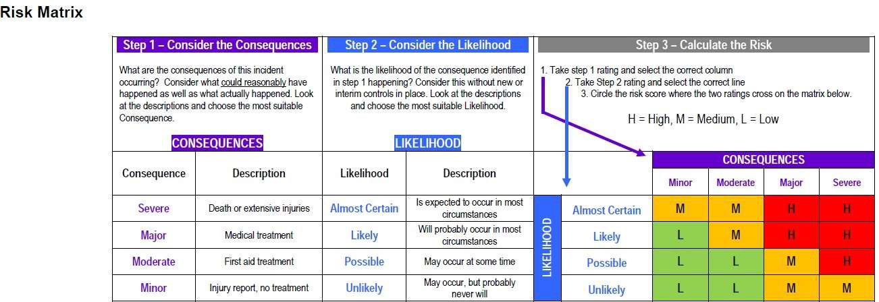
Risk Matrix
ECTE250- Engineering Design and Management 2

Slide 59
WHS for Innovation Fair
For Innovation Fair:
Select a member of your team to meet with Mr. Majid Munawar to discuss your project (need to make an appointment):
Show him the design and any moving parts and how power cables will be secured and all exposed wires covered with insulating material
With Mr. Majid Munawar, develop a WHS risk assessment for Innovation Fair.
ECTE250- Engineering Design and Management 2

